Slide 1
Digital Inclusion, Welfare Reform and Universal Credit What’s the hook?
Chris Swaine, emh group and Susan Easton, NIACE

Slide 2
Setting the scene
About the emh group.
About NIACE
The Dlit 2.0 project

Slide 3
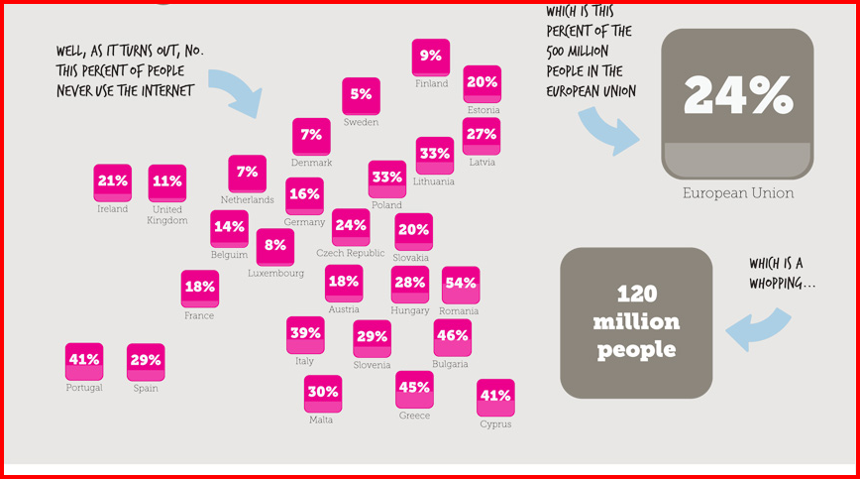
Isn’t everyone using the internet?
Data from eurostat. Infographic from We are what we do

Slide 4
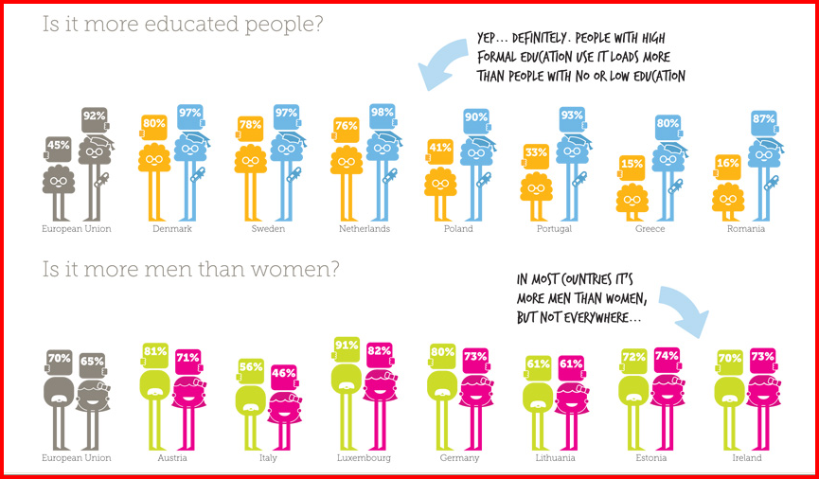
So what type of people are going online?
Data from eurosta. Infographics from We are what we do

Slide 5
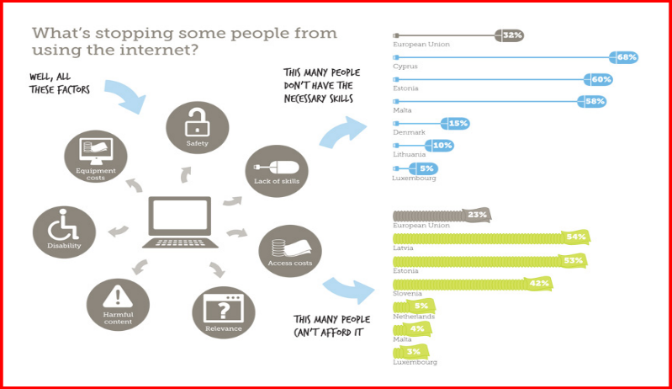
What’s stopping some people from using the internet?
Data from eurostat. Infographic from WE are what we do

Slide 6
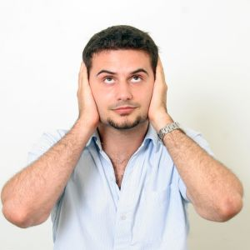
Education and Life Chances
Employment and Skills
Saving Money
Banking online
Online services
“Digital by Default” – Universal Credit
By next year, 20% of the country will:
Not be eligible for 90% of jobs
Not be able to claim benefit without support
Not be able to access majority of information
Be vulnerable to online dangers
4.1 million of the 8.7 million adults who have never been online live in social housing

Slide 7
Skills
Motivation
Confidence
Access

Slide 8
Skills?
Word Process...
Spreadsheets...
Data Input.....

Slide 9
Skills?
buying things
listening to music
getting information
meeting new people

Slide 10
Skills
Block 1: E – Citizenship
E-Democracy.
E-Commerce
E-Government
Block 2: Collaboration
Collaborative documents
Sharing
Block 3: Social networking
Employability
Connecting with others
Staying safe
Block 4: Communication
Online chat
Sharing knowledge
Publishing
Block 5: Basic Skills
Using hardware
Internet skills

Slide 11
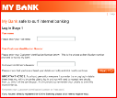
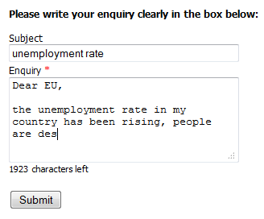
initiate or engage in a debate
initiate or sign a petition
ask a question or make a complaint
contact public services
use online government services
E-Government
E-Democracy
E-Citizenship
E-Commerce
search, browse and compare products
read other users‘ ratings and recommendations
order and pay online
manage money online

Slide 12
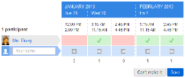
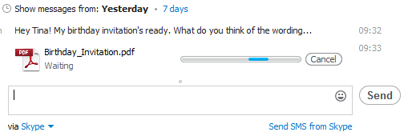
write a story with others
produce minutes collaboratively
read /create /edit
collaborative documents
arrange events with online calendars
create polls
Collaboration
sharing
use Dropbox or GoogleDocs to share documents
use instant messenger to exchange links or files
share photos

Slide 13
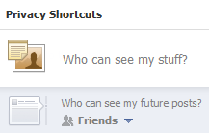
employability
staying safe
edit privacy settings
decide which info to publish
block other users
choose safe passwords
online communities for job opportunities
create an online employment profile
Social Networking
create and edit your profile
connect with friends
join groups
like“ others‘ comments, posts, photos etc.
get followers
follow a celebrity on Twitter and re-tweet tweets to your contacts
connect with old school-friends
review products
Create a Vlog,
connecting with others

Slide 14
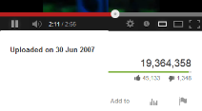
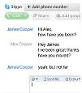
sharing knowledge
publishing
Create and publish your own…
Podcasts
Blogs,Vlogs and Boos
Videos
Photos
Literature
Communication
chat
create a virtual pinboard with Pinterest
write a poem or short story and publish on Scribd
Start a project in eHow
Use free online telephone
free online group chat
video-telephony
data transfer worldwide

Slide 15
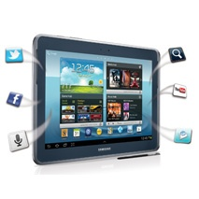
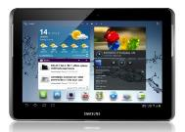
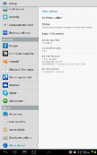
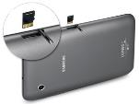
Hardware and software
create folders to rearrange apps.
connect to wifi or 3G.
find and suggest useful apps
Basic Skills
login
registering
information search
set up a web based email account
work safely in a digital world
accessibility
Internet skills

Slide 16
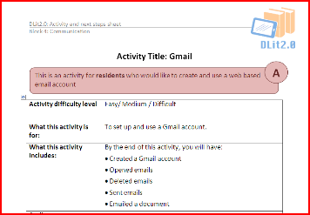
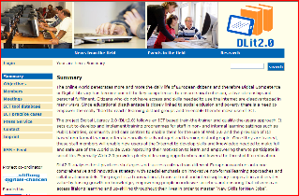
E.U. DLit Champion resources
Champion support resources
Presentations
Learner sheets

Slide 17
Motivation– what’s the hook? 13 reasons to get online

Slide 18
1. You can use the internet to find out information
You can search for, and easily find, information about almost anything, from bus timetables to library opening hours, weather forecasts to TV listings. Once you know how, searching for information is quick and easy to do.

Slide 19
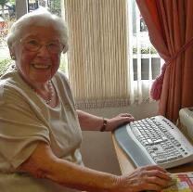
2. You can use email to keep in touch with your friends and family
You can keep in touch with friends and family by email. It is free to use and emails are delivered instantly.

Slide 20
3. You can do your shopping online
You can order your shopping online from all of the major supermarkets and get it delivered to your home.

Slide 21
4. You can make free phone calls using the internet
Using Skype you can make free phone calls over the internet.
All you need is a computer with internet, and a headset with a microphone.
You can call friends and family, anywhere in the world, for free.

Slide 22
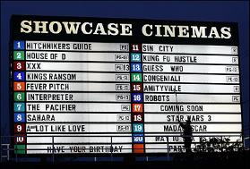
5. You can book tickets online
You can book tickets for all sorts of events online, including the theatre, cinema, sporting events, ballet, concerts and many more.
You can also book bus, train and aeroplane tickets online, often with cheaper prices!

Slide 23
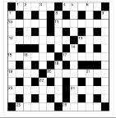
6. You can find out more about your hobbies and interests
You can use the internet to look for information about your favourite hobbies and interests – from cooking recipes to finding out what’s happening in your local community.

Slide 24
7. You can access the news online
You can access the news online through international websites such as the BBC News website, or national and local newspaper websites – and in many different languages.

Slide 25
8. You can take photos, create videos and send them to friends and family
You can use your smart phone or tablet to take photos or shoot videos and then send them by email to other people..
If your scheme has a scanner, you can make electronic copies of photos which can also be shared by email or printed out.

Slide 26
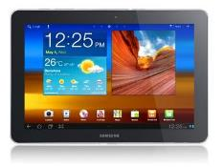
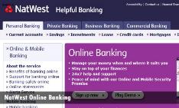
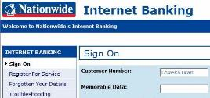
9. You can do your banking and pay your bills online
You can do your banking and pay your bills online rather than having to go to the bank. Follow some simple rules and banking online is safe and secure.

Slide 27
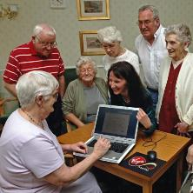
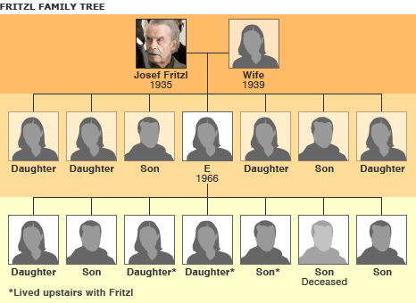
10. You can research your family history online
There are many websites which can help you to research your family history or family tree, for example by accessing Census information.

Slide 28
11. Find help and support
You can use the internet to find help and support when you need it.

Slide 29
12. Find friends, build relationships
Find and re-connect with friends or even develop new relationships

Slide 30
13. Get job skills and find work
Build CVs, get job skills, find jobs and develop professional networks

Slide 31
13. Keeping up with your kids
Whether it’s keeping up with your kids or grand children, the internet can help you to help them.

Slide 32
Confidence?
Non – threatening and inclusive
Welcoming / familiar surroundings
Support from “trusted intermediaries”
Regular access and use

Slide 33
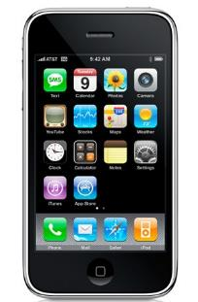
Access?
SmartPhone usage Aug 10
Source: OFCOM
By 2015, 80% of people accessing the internet will be doing so from mobile devices.
SmartPhone usage Sept 11
Source: OFCOM
K

Slide 34
Skills
Motivation
Empower as well as train – develop skills they needed for the future – not just for today
Confidence
Access
Engage and motivate to go online by keeping digital skills relevant and useful to real life needs
Non - pressurised learning contexts where champions understand needs
Support from “trusted intermediaries” – Digital Champions
Residents themselves have a role to play
Smart mobile devices make skills easier to learn
Residents can use their own devices

Slide 35
ICT infrastructure
‘The hardware, software, and connectivity solutions necessary to enable the Group to effectively utilise technology across the business.’
11 pilot locations across East Midlands focusing on 4 key target groups: BME communities, older people, sufferers of domestic violence (DV) and homeless.
Tablets in each location (android Samsung Tab 2, 10.1, 3G and WiFi) – next generation devices; relationship with smart phones, technology mobility. Freedom from Apple & Microsoft. 4 devices into each location for residents to learn from.
Wifi into public spaces and 3G for DV.
Sat outside of existing ICT infrastructure
Apps

Slide 36
Digital skills
The ability of our staff at all levels to effectively use and deploy technology as part of their everyday work.
20 digital champions trained across the emh group, via 2 days training.
All champs got their own tablet to ‘play with’
Geeks not allowed – good communicators encouraged.
Use of VLE to support.
Champs ‘buddied up’ to support each other.
Valued, empowered and supported.

Slide 37
Content and delivery
5 curriculum areas: citizenship; communication; collaboration; social networking; basic skills.
‘What’s the hook’ - 15 reasons to get online.
Heutagogic approach – the learner decides what they want to learn and also decides what success looks and feels like.
Different approaches: 1:1, 1:many; P2P, independent
20 digital champs – 2 days training
Production of learner sheets – less about step 1, 2, 3
‘working safely online’ really important for all groups

Slide 38
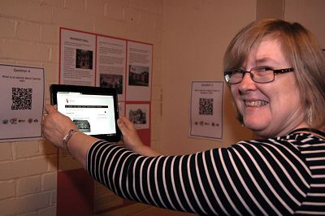
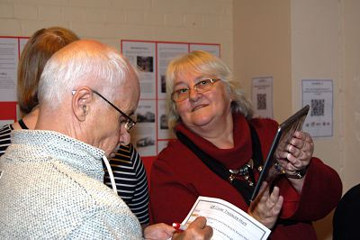
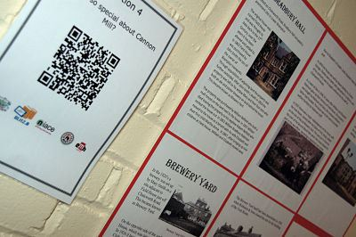
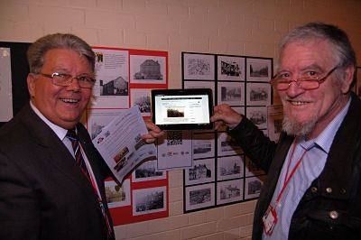
Connelly Court – 25 year anniversary
Residents celebrating 25 year anniversary. Local history QR code treasure trail with audio

Slide 39
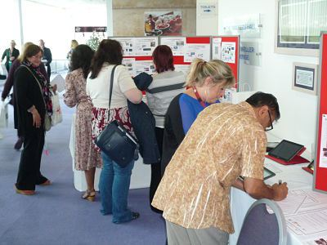
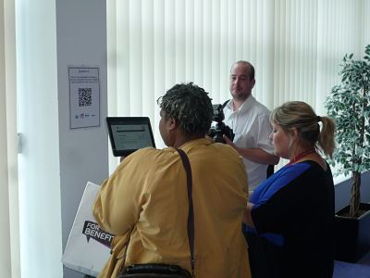
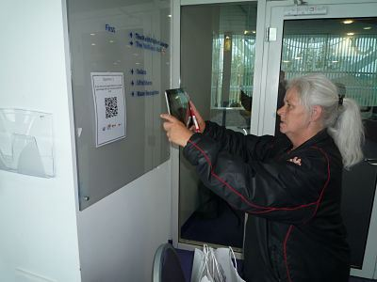
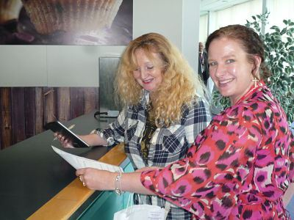
Residents Welfare Reform conference
QR code treasure trail about Welfare Reform and Universal Credit.
Just think what you can do with QR Codes as an inclusion tool?

Slide 40
Does it make a difference?
Baska Read
https://www.youtube.com/watch?v=uQKSUr8X3w4
What can it lead to?
Promoting apprenticeships – Apprentice Shake - dubstep style

Slide 41
Lessons learned
Homeless adults have very chaotic lives and often present with other issues. Small issues can be big issues.
Job search for unemployed a key driver.
Don’t be fooled by young adults having digital skills – but equally don’t ignore their value and how they can help.
Use of QR codes to support language translation – oh and don’t forget google translate!
Working safely online is critical. Young people and DV
No one size fits all model.
Staff digital skills improved.
Don’t ignore the constituency of existing digital learners.
‘The hook’ is a crucial part of engagement.
Infrastructure is crucial – the business must drive the digital agenda.
The numbers game is a false economy – don’t kid yourself – we need digital literacy.

Slide 42
Discuss:
How do you develop a sustainable and affordable digital inclusion model for your own organisation?

Slide 43
Want more information?
Contact Chris Swaine, emh group on 01530 276 000, email chris.swaine@emha.org, mobile: 07919 497 756 or Skype: emhgchris
Susan Easton, NIACE on 07795 227 283, email susan.easton@niace.org.uk

