Slide 1



Phil Pemberton
Managing Director, Sovini Property Services
Lucien Wynn
Managing Director, Oneserve

Slide 2


Project 65 in a nutshell

Slide 3

Context

Slide 4

Voids

Slide 5

Gas

Slide 6
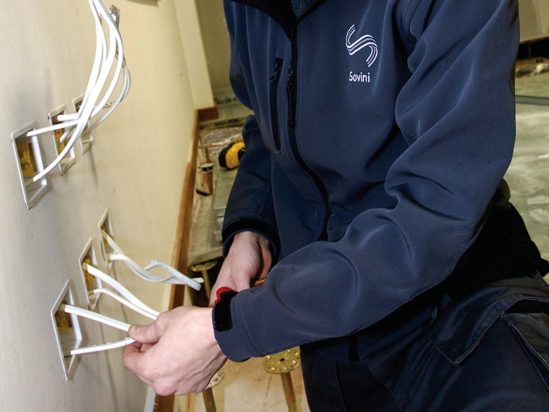
Repairs

Slide 7

People

Slide 8

Preparation

Slide 9

Implementation
Repairs

Slide 10

Results

Slide 11

Top Tips
Repairs

Slide 12

Any
Questions?

