Slide 1
E-RP?
New solutions thinking in the Housing Sector
Empowering your customers
Improving service delivery
Aidan Dunphy, Head of Product Strategy
February 2014

Slide 2










Orchard
Company Overview
An independent limited company
Dedicated to Social Housing Sector
27% of housing management market*
Annual revenues of £14.5 million
Continuous investment in product
2013 acquired in4systems (Promaster)
Close relationship with customers
170+ Customers
* Housemark 2013
February 2014
Aidan Dunphy, Product Manager

Slide 3

E-RP?
How did we get to where we are today?
Councils
In-house/bespoke
Character / terminals
Little/no integration
Unsustainable
Looking for packaged “off the shelf” solution
Birth of the IHMS
February 2014
Aidan Dunphy, Head of Product Strategy

Slide 4
E-RP?
The Integrated Housing Management System
Common person/property/tenancy database
Rents
Arrears
Responsive Repairs
Contractor
Planned Maintenance
Allocations & CBL
Voids
Leaseholders
Estates
Supporting People
February 2014
Aidan Dunphy, Head of Product Strategy

Slide 5



E-RP?
How did we get to where we are today?
CRM
Workflow
Web
Integration
Microsoft!
Mobile
February 2014
Aidan Dunphy, Head of Product Strategy

Slide 6
E-RP?
The Integrated Housing Management System
Common person/property/tenancy database
Rents
Arrears
Responsive Repairs
Contractor
Planned Maintenance
Allocations & CBL
Voids
Leaseholders
Estates
Supporting People
February 2014
Aidan Dunphy, Head of Product Strategy

Slide 7
E-RP?
How did we get to where we are today?
CRM
Mobile
Common person/property/tenancy database
Rents
Arrears
Responsive Repairs
Contractor
Planned Maintenance
Workflow
Allocations & CBL
Voids
Leaseholders
Estates
Supporting People
Web
February 2014
Aidan Dunphy, Head of Product Strategy

Slide 8


E-RP?
How did we get to where we are today?
Global financial meltdown
Social media
Cloud
Consumerisation
BYOD
Big data
Apple!
Google!
February 2014
Aidan Dunphy, Head of Product Strategy

Slide 9
E-RP?
HR
How did we get to where we are today?
EDM
Development
Care & Support
Mobile
Payroll
Portals
Mobile
CRM
Asbestos
Options Appraisal
Asset
Common person/property/tenancy database
Rents
Arrears
Self Service
SMS
Diary
Projects
Responsive Repairs
Contractor
Planned Maintenance
Performance Management
Apps
Workflow
Allocations & CBL
Intranet
Mobile
Voids
Leaseholders
Estates
Supporting People
Knowledge Base
BI
ASB
Social media
Finance
Scheduling
Automated voice
GIS
February 2014
Aidan Dunphy, Head of Product Strategy

Slide 10
E-RP?
How did we get to where we are today?
Things an IT solution could do
Things that would actually help your business and are cost effective
What you think you need
What your packaged solution delivers
CHANGE
Sales magic
February 2014
Aidan Dunphy, Head of Product Strategy

Slide 11
E-RP?
The build it yourself approach (AKA “bottomless pockets”)
February 2014
Aidan Dunphy, Head of Product Strategy

Slide 12

E-RP?
The build it yourself approach (AKA “bottomless pockets”)
February 2014
Aidan Dunphy, Head of Product Strategy

Slide 13
E-RP?
The build it yourself approach (AKA “bottomless pockets”)
“We’ve got a really good IT team”
Approach:
Develop your own solutions (e.g. in Microsoft Dynamics)
Repurpose tools such as Financials
Integrate systems using middleware (e.g. BizTalk)
Pros:
You get what you want! Yay!
It’s cheap! At first…
Cons:
Risk due to heavy reliance on in-house support
Lots of points of failure
Growing support burden
February 2014
Aidan Dunphy, Head of Product Strategy

Slide 14


E-RP?
The economics of software development
Hard work
Each product needs 3-4 sales to achieve payback
Ongoing support burden for each product
Support grows as product is enhanced
February 2014
Aidan Dunphy, Head of Product Strategy

Slide 15
E-RP?
Product Lifecycle: adoption
Percentage of adopters
Innovators
2.5%
Early Adopters
13.5%
Early Majority
34%
Late Majority
34%
Laggards
16%
Time
February 2014
Aidan Dunphy, Head of Product Strategy

Slide 16
E-RP?
Product Lifecycle: phases
Rapid volume increase
Competitors increase
Economies of scale
Slightly lower prices
‘Buy-me’ marketing
Limited growth
Lower prices
Replacement products
Volumes drop sharply
Competitors withdraw
Prices can rise
Marketing effort reduced
Limited competition
Market domination potential
Low volume
High Cost
High failure rate
‘Try-this’ marketing
Revenue / Profit
Steady state (cash cow)
Retirement
Introduction Growth Maturity Decline
Time
February 2014
Aidan Dunphy, Head of Product Strategy

Slide 17
E-RP?
Product Lifecycle: the Minimum / Optimum Viable Product
Development spend
Target zone
Revenue
Revenue / Spend
Profit
Wasted effort
MVP OVP
Time
February 2014
Aidan Dunphy, Head of Product Strategy

Slide 18
E-RP?
Victims of our own success
“Prolonged product portfolio proliferation precipitates progress paralysis.”
- Me, 2014
February 2014
Aidan Dunphy, Head of Product Strategy

Slide 19
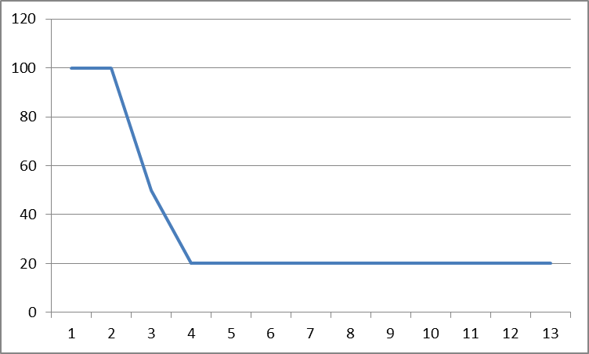
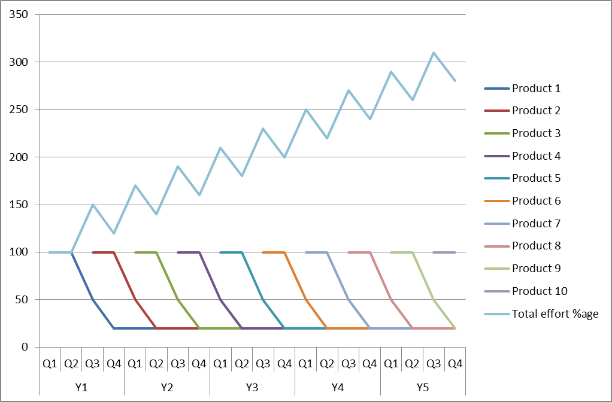
E-RP?
A pink fluffy world view of support
Assumptions:
First six months 100% effort
3 months 50% effort
Ongoing commitment 20% effort
February 2014
Aidan Dunphy, Head of Product Strategy

Slide 20
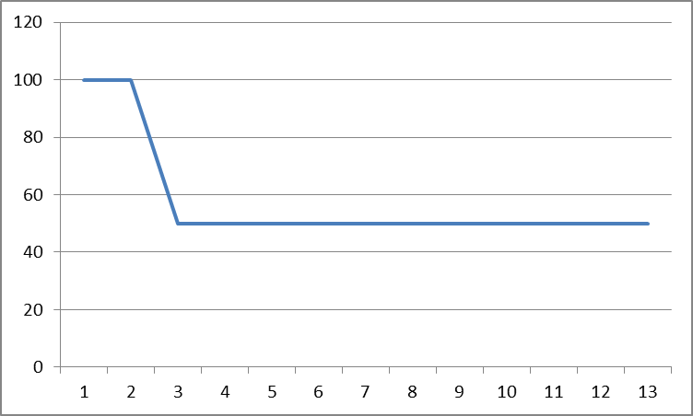
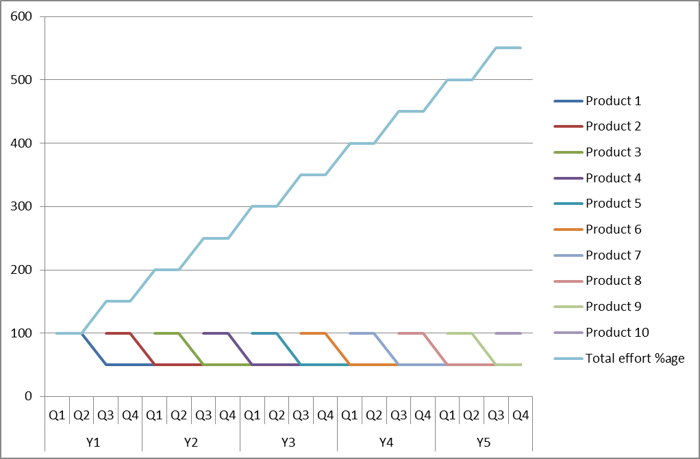
E-RP?
Reality
Assumptions:
First six months 100% effort
Ongoing commitment 50% effort
February 2014
Aidan Dunphy, Head of Product Strategy

Slide 21
E-RP?
The build it yourself approach (AKA “bottomless pockets”)
Questions:
What is your key role and competency? Are you a software house?
How many clients does your software development facility have?
How can they support in-house solutions in the long term?
Will you ever achieve IT perfection?
February 2014
Aidan Dunphy, Head of Product Strategy

Slide 22
E-RP?
What do you need?
February 2014
Aidan Dunphy, Head of Product Strategy

Slide 23
E-RP?
What do you need?
“I will never buy an integrated housing management system again.”
…but do you still need an IT system to help you manage your housing, which is integrated?
February 2014
Aidan Dunphy, Head of Product Strategy

Slide 24
E-RP?
Introducing…
The IHMS is dead. Long live the…
SHMI
February 2014
Aidan Dunphy, Head of Product Strategy

Slide 25
E-RP?
Integrated business solutions
February 2014
Aidan Dunphy, Head of Product Strategy

Slide 26
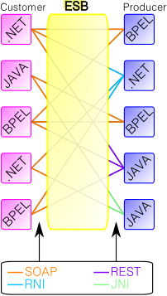
E-RP?
Integration
February 2014
Aidan Dunphy, Head of Product Strategy

Slide 27
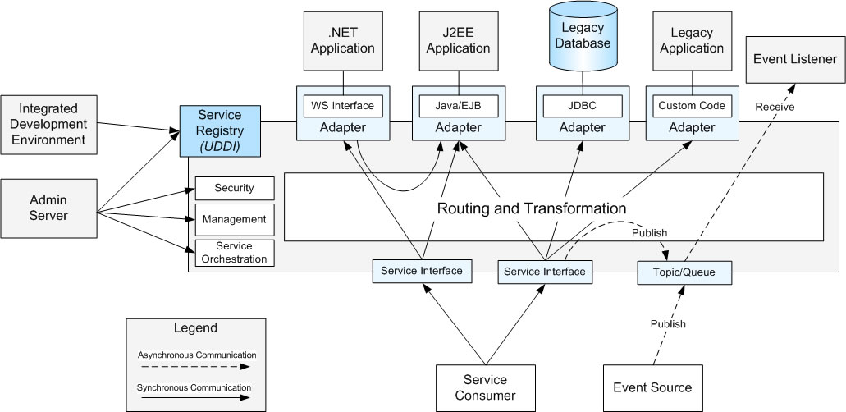
E-RP?
Integration
February 2014
Aidan Dunphy, Head of Product Strategy

Slide 28
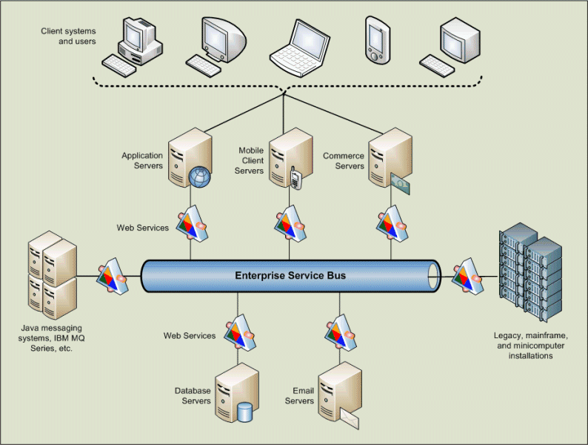
E-RP?
Integration
February 2014
Aidan Dunphy, Head of Product Strategy

Slide 29
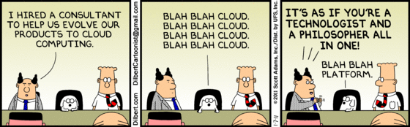
E-RP?
Why do you care what’s under the bonnet?
Q: Why did the chicken cross the road?
A: Cloud.
February 2014
Aidan Dunphy, Head of Product Strategy

Slide 30
E-RP?
OK then, so what is ERP?
February 2014
Aidan Dunphy, Head of Product Strategy

Slide 31
E-RP?
What is it again?
What is ERP?
Supply Chain Management
Project Management
Financial Management
Who needs ERP?
Fragmented, fragile patchwork
Duplication, poor data quality, inefficient process
Difficult getting reports / BI / SVOT
Triggers managed manually
Who are we talking to, about what?
February 2014
Aidan Dunphy, Head of Product Strategy

Slide 32
E-RP?
Who supplies ERP?
Netsuite ERP
Aptean ERP
Friedman Frontier ERP
Epicor ERP
Plex Systems Plex Online
Microsoft Dynamics GP
Intacct Accounting
Syspro
Sage ERP X3
Global Shop Solutions One-System ERP
IFS Applications
Unit4 Agresso
SAP ERP
Kenandy Social ERP
VAI S2K Enterprise
IQMS EnterpriseIQ Manufacturing ERP
Assist Cornerstone Commerce Suite
Oracle E-Business Suite
Infor LN
Blue Link lite ERP
February 2014
Aidan Dunphy, Head of Product Strategy

Slide 33
E-RP?
What should it do?
MUST
Comprehensive IT solution
One version of the truth
Seamless flow of data and tasks
Easy reporting and powerful BI
SHOULD
Familiar, consistent look and feel throughout
Good fit to existing/future business processes
February 2014
Aidan Dunphy, Head of Product Strategy

Slide 34
E-RP?
What should it do?
COULD
Right technology platform
Flexible/customisable
Low risk
WON’T
Fix your business
Achieve perfection
Be completed (see “change”)
February 2014
Aidan Dunphy, Head of Product Strategy

Slide 35
E-RP?
What should it do?
SHOULDN’T
Become a failed dream
DOESN’T HAVE TO
Be called “ERP”
February 2014
Aidan Dunphy, Head of Product Strategy

Slide 36
E-RP?
Who should do this?
February 2014
Aidan Dunphy, Head of Product Strategy

Slide 37
E-RP?
Commercial thinking
Increased pressures on RPs’ finances:
Changes in funding
Recession – increased hardship
Welfare Reform – decreased benefits, changes in payment patterns
How to balance the books?
Increase commercial activity
Restructure, create commercial company
Rebrand, reposition group
“We’re a business that happens to do Social Housing.”
February 2014
Aidan Dunphy, Head of Product Strategy

Slide 38
E-RP?
Is Social Housing just another business?
Do private sector landlords:
Have a responsibility to house people?
Align rent payment schedules with patterns of pay?
Offer financial management support?
Manage anti-social behaviour?
Promote involvement?
Run their business on a not-for-profit basis?
February 2014
Aidan Dunphy, Head of Product Strategy

Slide 39
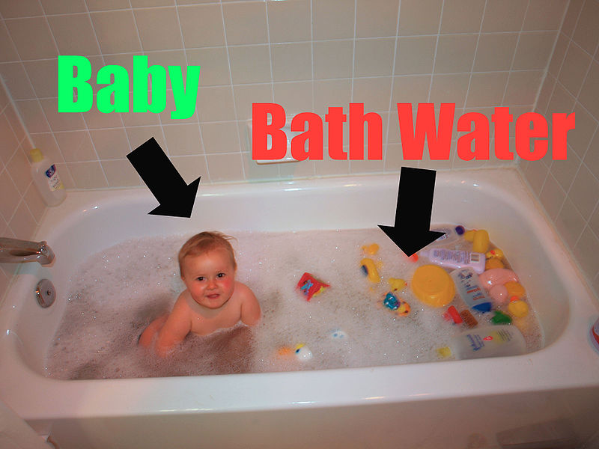
E-RP?
Is Social Housing just another business?
February 2014
Aidan Dunphy, Head of Product Strategy

Slide 40
E-RP?
Summary
You need an agile, fit-for-purpose business solution which meets your needs today and in the future.
This needs to be integrated, scalable and use the right technology to support future growth.
Social Housing is not like other businesses, and you need IT partners who understand that.
February 2014
Aidan Dunphy, Head of Product Strategy

Slide 41
E-RP?
Questions?
February 2014
Aidan Dunphy, Head of Product Strategy

