Slide 1
Influencing behaviour – can housing learn lessons from health advocates?
Francesca Nelson
Saxon Weald

Slide 6
YouTube clip

Slide 8
From The Sunday Times, 2012

Slide 10
Key findings
All had partners who were working
All knew something about Universal Credit, but were unsure about the detail
None wanted the responsibility of administering her housing benefit
All feared that they would not be able to budget using a single payment
Two of the three regularly borrowed money from relatives to tide them over, and one of those had also borrowed money from a payday lender
All knew that that rent arrears could mean eviction, even for families
All said that they ‘knew’ they would spend the money allocated to housing benefit on other things

Slide 11
What can we do about it?

Slide 13
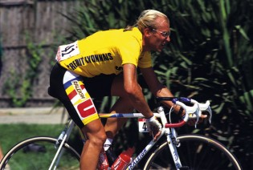
From Cycling Week, 2010

Slide 14
Thank you.
francesca.nelson@saxonweald.com

