Slide 1
BT, taking technology forward.
Colin Lees, CIO, BT Business.

Slide 2
Business & Public Sector

Slide 3

Technology changes happening today
Convergence
First in how we purchase then in how the technology works together.
The move to new technology – cloud, “All IP”, apps
A number of transformational technology changes are quickly moving from slides to reality!
The need for speed
From 5-10 Meg Broadband To 20-100 Meg and beyond. The demand for speed is ever increasing.

Slide 4


Our new products reflect how technology is changing
BT One Phone
APP Direct
BT Cloud Voice

Slide 5

“ The CIO has a critical role to play making sure that the technology roadmaps are informed by the business and that the business roadmaps are informed by technology. Making technology a driving force behind a business”

Slide 6
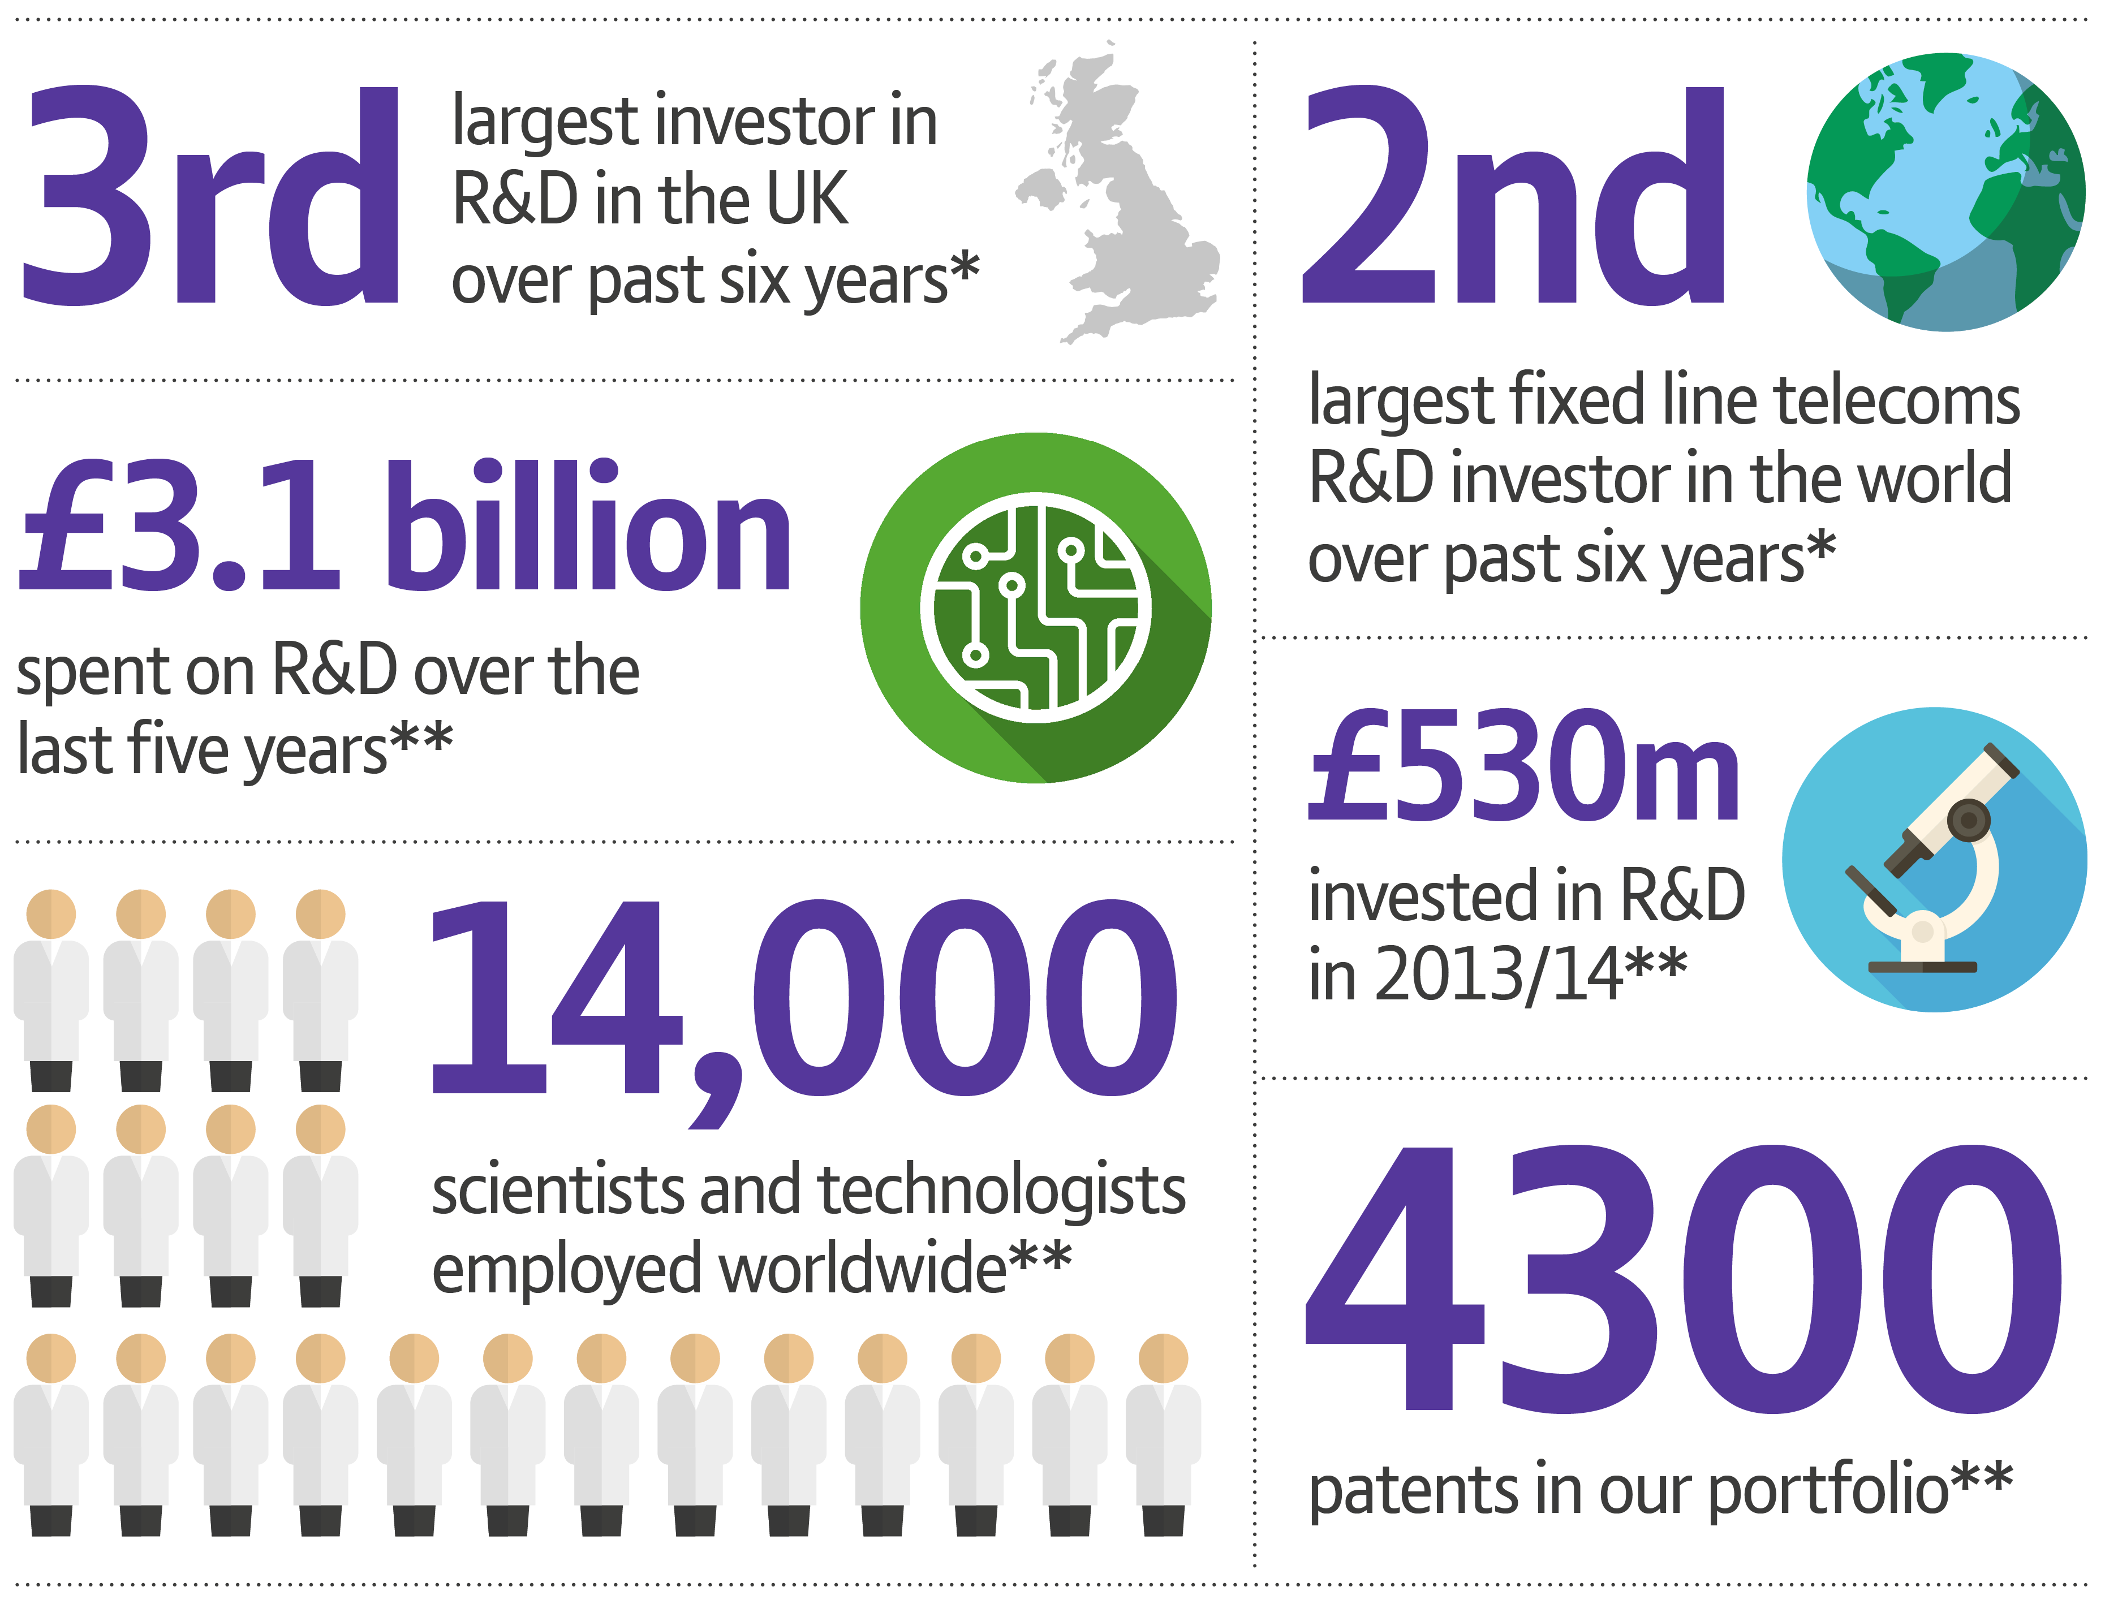

We’re investing in the future.
BT research and development activities
* Source: EU Industrial R&D investor Scoreboard 2009-2014
** Source: British Telecommunications plc Resort & Accounts 2014

